Slide 1
CS310 Operating Systems Lecture 7: Process – fork() system call
Ravi Mittal
IIT Goa

Slide 2
Acknowledgements !
Contents of this class presentation has been taken from various sources. Thanks are due to the original content creators:
Class presentation: University of California, Berkeley: David Culler, Anthony D. Joseph, John Kubiatowicz, AJ Shankar, George Necula, Alex Aiken, Eric Brewer, Ras Bodik, Ion Stoica, Doug Tygar, and David Wagner
Operating Systems: Three Easy Pieces, by Remzi and Andrea Arpaci-Dusseau,
Chapter 5: Process APIs
Programs are taken from this chapter

Slide 3
Read the following:
Operating Systems: Principles and Practice (2nd Edition) Anderson and Dahlin
Volume 1, Kernel and Processes
Chapter 4
Operating Systems: Three Easy Pieces, by Remzi and Andrea Arpaci-Dusseau,
Chapter 5: Process APIs

Slide 4
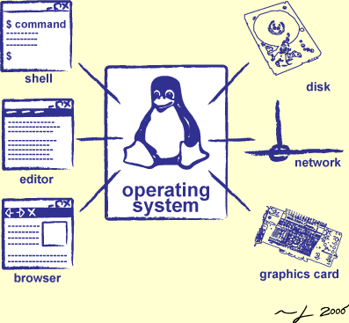
We will study..
Fork() system call

Slide 5
We have studied so far …

Slide 6
System Calls (“Syscalls”)
Word Processing
Compilers
Web Browsers
Email
Databases
Web Servers
Application / Service
Portable OS Library
OS
User
System Call
Interface
System
Portable OS Kernel
Software
Platform support, Device Drivers
Hardware
x86
PowerPC
ARM
PCI
Ethernet (1Gbs/10Gbs)
802.11 a/g/n/ac
SCSI
Graphics
Thunderbolt
Crooks & Joseph CS162 © UCB Spring 2021

Slide 7
OS Library Issues Syscalls
Proc 1
Proc 2
Proc n
…
OS
Appln
login
Window Manager
…
libc
OS library
OS library
OS library
OS
Crooks & Joseph CS162 © UCB Spring 2021

Slide 8
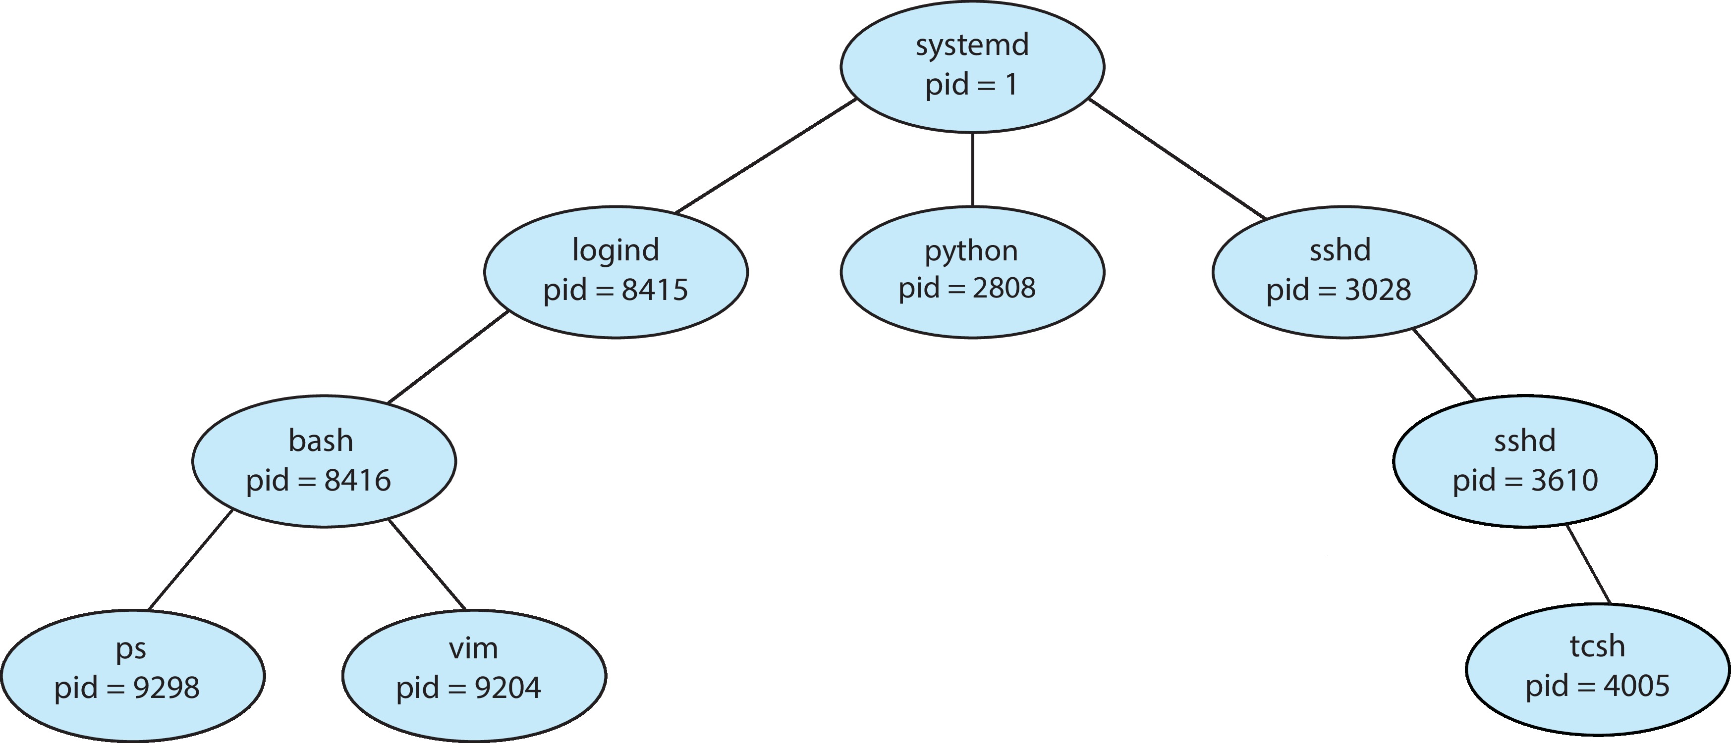
A Tree of Processes in Linux
Secure Shell
ps -el command gives details of all active processes in the system

Slide 9
Process Creation
During execution, a process may create several new processes
Creating Process: Parent Process
New Processes: Children Processes
Each of the children process may create other processes
Forming Tree of processes
The systemd process (which always has a pid of 1) serves as the root parent process for all user processes
Systemd process in Unix is called init process

Slide 10
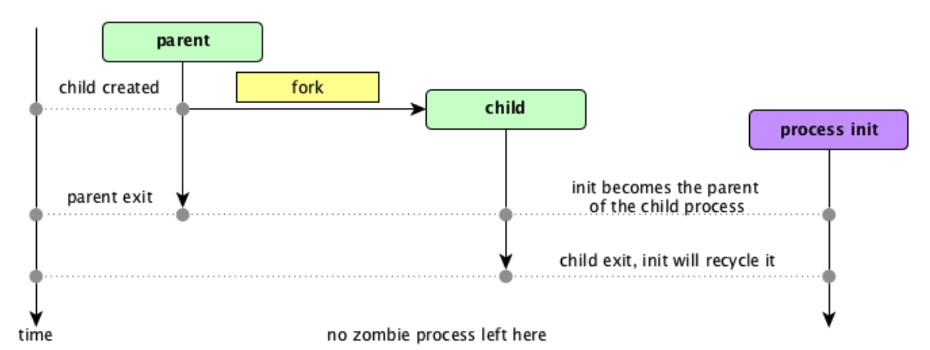

Process creation and termination – snapshot - 1
In case the parent dies, init becomes parent of the child

Slide 11
Another Data structure – Process Table
Used in Linux

Slide 12
System Calls

Slide 13
Process Related System Calls (in Unix)
fork() creates a new child process
All processes are created by forking from a parent
The init process is ancestor of all processes
exec() makes a process execute a given executable
exit() terminates a process
wait() causes a parent to block until child terminates
There are many variants of the above system calls with different arguments

Slide 14
System Calls – fork()

Slide 15
Creating a Process (Linux)
All processes are created using fork system call
Creates an exact copy of the current process
Both processes continue in parallel from the statement that follows the fork call
The only difference is in the return value
Parent: Child process ID (“pid” , non–zero)
Child: 0
Child can get parent ID via getppid()
Failure: -1

Slide 16
Actions during a fork
A new process is created by making a copy of parent’s memory image
In a separate address space
The new process is added to the process list and scheduled
Parent and child start execution just after fork (with different return values)
Parent and child execute and modify the memory data independently
Fork copies variables and registers from the parent to the child

Slide 17
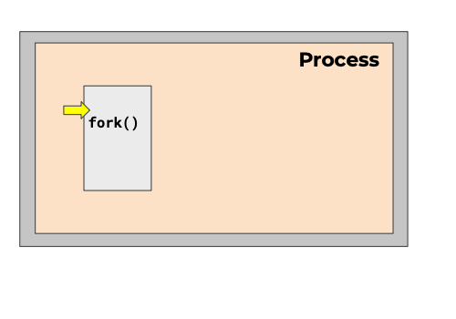
Creating a process
Just one process – Parent process
CS 423 Operating System Design, Uinv of Illinois, Prof Fagen-Ullmschneider

Slide 18
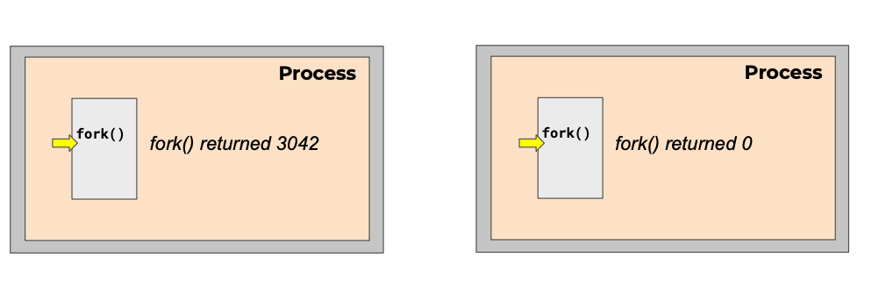
Creating a process
Just one process – Parent process
Initially there is one process – init with id = 1
id = 1
id = 3042
ppid() = 1
CS 423 Operating System Design, Uinv of Illinois, Prof Fagen-Ullmschneider

Slide 19
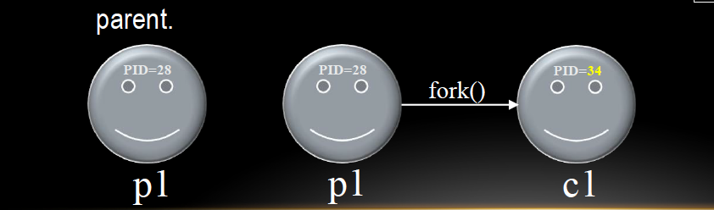
Fork() is fun..
The fork() is one of the those system calls, which is called once, but returns twice

Slide 20
#include <stdio.h>
#include <stdlib.h>
#include <unistd.h>
int main(int argc, char *argv[]){
printf("hello world (pid:%d)\n", (int) getpid());
int rc = fork();
if (rc <0){
//fork failed
fprintf(stderr, "fork failed\n");
exit(1);
} else if (rc ==0) {
//child new process
printf("hello I am child process with (pid = %d) \n", (int) getpid());
} else {
//parent
printf("hello I am parent of %d (pid: %d) \n", rc, (int) getpid());
}
return 0;
}
p1.c

Slide 21
(base) Ravis-MacBook-Pro-2:Cprograms ravimittal$ ./a.out
hello world (pid:22305)
hello I am parent of 22306 (pid: 22305)
hello I am child process with (pid = 22306)

Slide 22
Notes on Fork()
Note that the child isn’t an exact copy
It has it’s own copy of the address space
It’s own registers, PC, etc
Value it returns is different from it’s parent
The output of p1.c is not deterministic
After child process is created – there are two active processes
On a single CPU, it depends on scheduler which one gets scheduled first. For example, in another run we might get:
Ravis-MacBook-Pro-2:Cprograms ravimittal$ ./a.out
hello world (pid:22394)
hello I am child process with (pid = 22395)
hello I am parent of 22395 (pid: 22394)

Slide 23
Class Summary
fork() and exec() combination is a powerful way to create an manipulate processes
In the next class we will study exec() system call

Slide 24
Next Class System Calls – exit, wait and exec

Slide 25
System Calls – exit() and wait()

Slide 26
Process termination
Multiple ways for a process to get destroyed
Process issues and exit() call – Voluntary
The parent process issues a kill() call - Involuntary
Process receives a terminate signal - Involuntary
When it did something illegal !
On death
Reclaim all of process’s memory regions
Make process un-runnable
Put the process in the zombie state
However, do not remove its process descriptor from the list of processes

Slide 27
Zombie State
Why keep process descriptor around?
Parent may be waiting for child to terminate
via the wait() system call
Parent needs to get the exit code of the child
this information is stored in the descriptor
If descriptor was destroyed immediately, this information could not be gotten
After getting this information, the process descriptor can be removed
no more remnants of the process

Slide 28
Waiting for children to die with wait()
The parent can wait for the child to die by executing the wait system call
It is quite useful for a parent to wait for a child process to finish what it has been doing
on success, returns the process ID of the terminated child; on error, -1 is returned.

Slide 29
wait and waitpid syscalls
A terminated process’s information is collected via a call of a wait operation by its parent
Operations:
wait
blocks the calling process until a child process terminates, returning the child’s pid
If caller has no children, wait immediately returns –1 (error)
the termination status (return value) of the child may be obtained via the argument
waitpid
permits a caller to wait for a particular child, identified by its pid

Slide 30
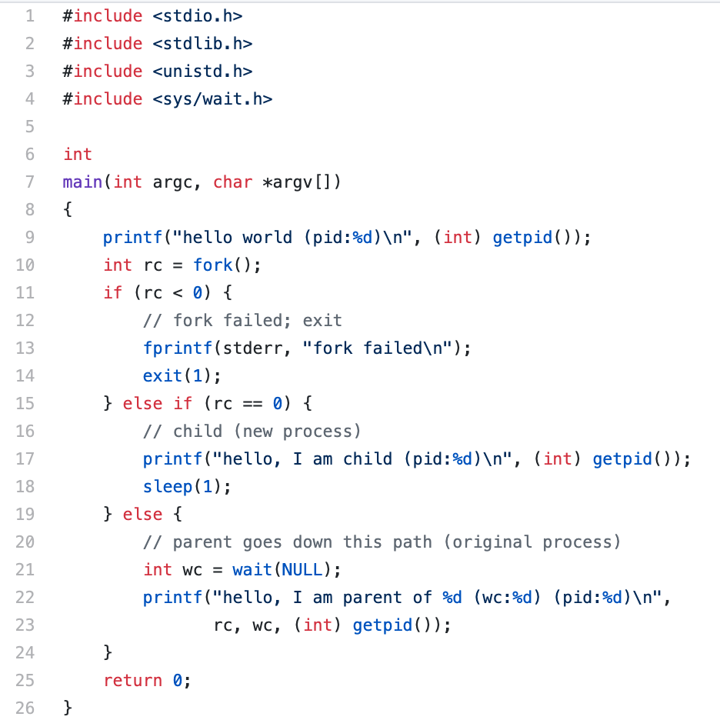
wait() system call
p2.c

Slide 31
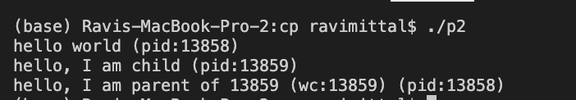
wait() system call
Parent process waits for the child to finish

Slide 32
Executing a new program
After fork, parent and child are running same code
Not too useful!
A common use of fork is to launch a new executable program
A process can run exec() to load another executable to its memory image
So, a child can run a different program from parent
The exec system call replaces the current process image with a new image
If exec succeeds, it never returns
exec requires you to specify the file you program to run

Slide 33
exec() system call
The exec family of system calls replaces the program executed by a process
When a process calls exec, all code (text) and data in the process is lost and replaced with the executable of the new program
All open file descriptors remains open after calling exec
unless explicitly set to close-on-exec

Slide 34
exec() system call
We consider system call: execvp()
execvp system call requires two arguments
The first argument is a character string that contains the name of a file to be executed
The second argument is a pointer to an array of character strings. More precisely, its type is char **

Slide 35
execvp() system call
When execvp() is executed, the program file given by the first argument will be loaded into the caller's address space
duplicate the actions of the shell in searching for an executable file if the specified file name does not contain a slash (/) character
The second argument will be provided to the program. It’s argument vector. The first argument points to the filename associated with the file being executed. The array of pointers must be terminated by a NULL pointer.
#include <unistd.h>
int execvp(const char *file, char *const argv[]);

Slide 36
More on Process APIs
kill() system call is used to send signals to a process
To pause, die, and other imperatives
In shells, certain keystroke combinations are configured to deliver a specific signal to the currently running process
control-c sends a SIGINT (interrupt) to the process (normally terminating it)
control-z sends a SIGTSTP (stop) signal thus pausing the process in mid-execution
Can use bg command to resume

